Slide 2


objective

Slide 3
Requirement pics

Slide 5
Functional Requirements:
The following are functional requirements of the system:
To implement a User interface on the system
User-friendly front-end design using Cascading Style Sheets.
Strong authentication while performing various operations.
Java script validations and alerts wherever needed.

Slide 6
Non-Functional Requirements:
The following are non-functional requirements of the system:
Secure access of confidential data (users details). SSL can be used.
Better component design to get better performance at peak time.
Flexible service-based architecture will be highly desirable for future extension.

Slide 7
Software quality attributes | Description
Compatibility | The developed software must be compatible with different OS and must be fully functional with various browsers
Transparency | Transparency from the end-user point of view. Any alterations made in the timetable must be visible to both lecturers and students.
Flexibility | Flexibility must be provided to the lecturers in order to schedule or cancel any classes and to students in order to raise any queries.
Scalability | The software should be scalable for any number of users.

Slide 8
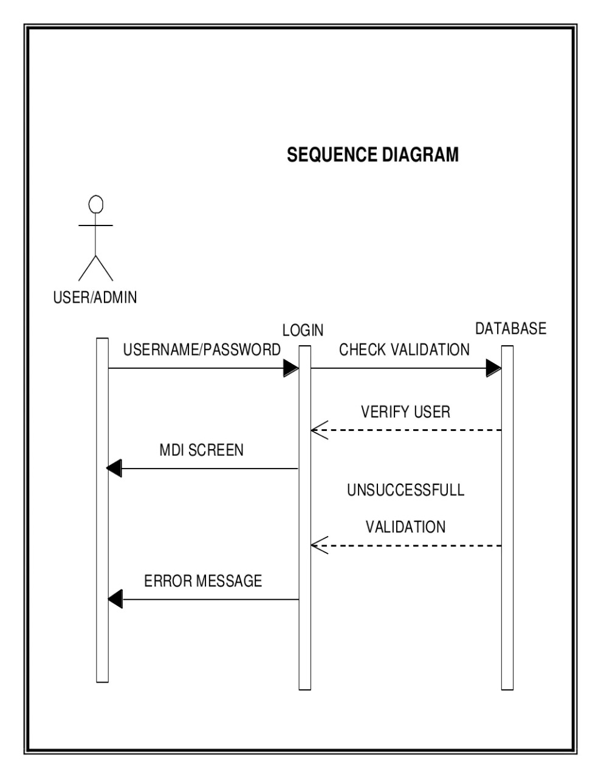

Slide 9
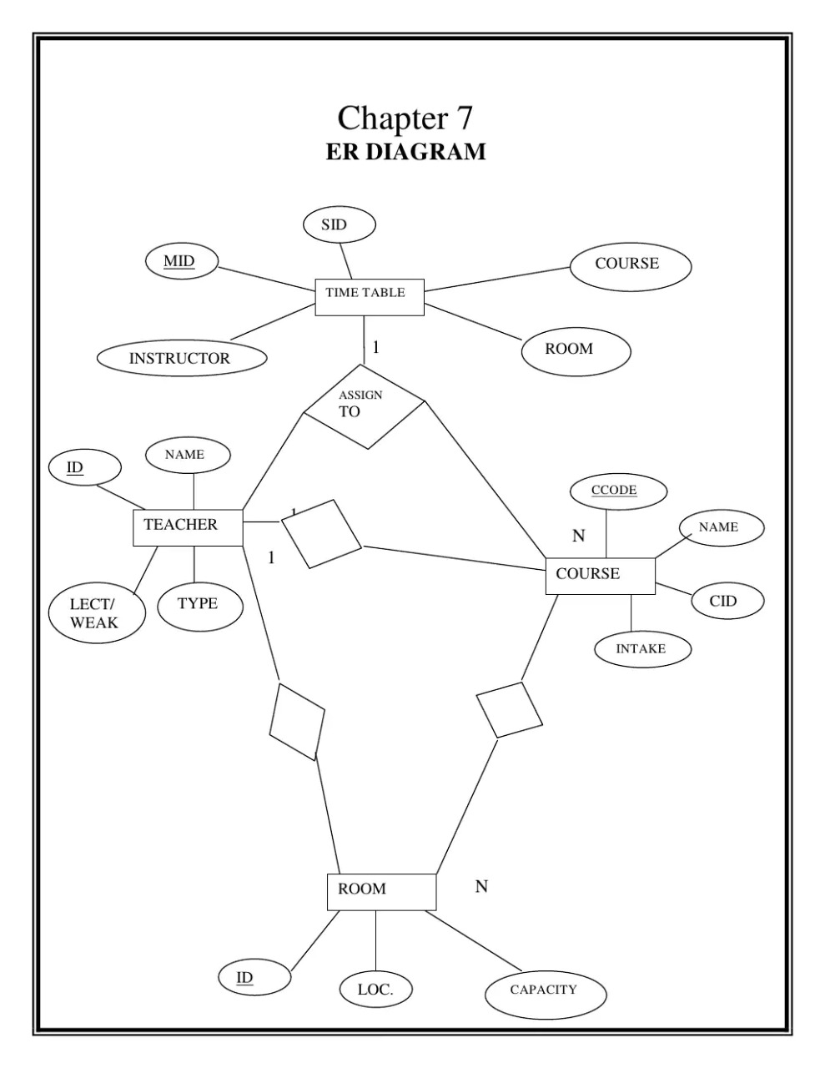

Slide 10
Stakeholder pic

Slide 11
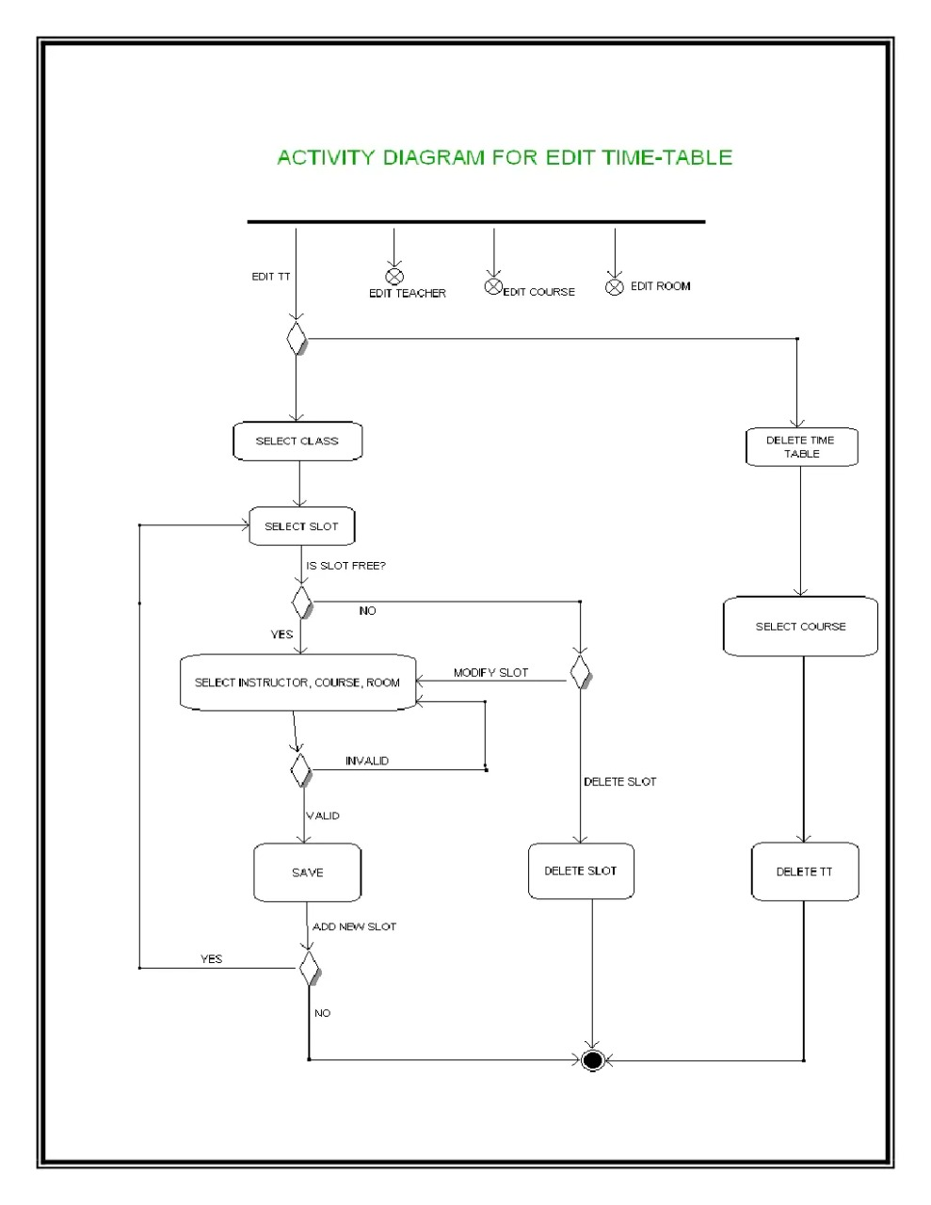

Slide 12
MODULARITY

Slide 14
Constraints pic online meet

Slide 15
constraints
Hard constraints
-A classroom cannot be assigned to more than one lecturer at the same time
An instructor connot be assigned to engage more than one class at a time.
The classroom for a course should have enough capacity to take students registered in the course.
The classroom should be well equipped with required facilities.

Slide 16
Soft Constraints
instructors daily lecture hours should be restricted to be with in the allowed maximum hours.
as far as possible, classes are scheduled in instructors preferred time zone.
A breakfast/lunch break must be scheduled.
Query box should be designed for any kind of mentorship activities.

Slide 17
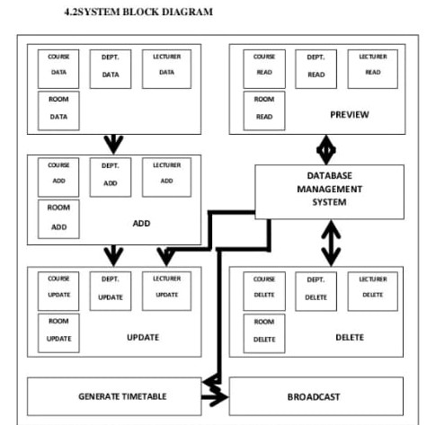
Incremental model

Slide 18
‌
1.communication
Communicate with the entire departments to get idea of what and all subjects are there
What faculties are there
Is there any time here a particular faculty can't engage because of personal reason.
‌2.Planning
We should plan the construction of time table in such a way that every class gets no more than 6 hours of classes per day
Scheduling of time
Teachers not having continuous classes
Correct hour for break
Every subject should hav equal number Or based on the credits given to the class in a week
3.Analysis
Time table execution is done by:
The submission of examinable and non examinable courses by the time-table officer of each dept
‌4. increment
Every teacher change
Every subject change
When student don't want to have the existing one -- like for only 2 classes coming to college

Slide 19
conclusion

